Slide 1
Soft Jellyfish Propulsion Simulation Midterm Status Update
By: Robert Marlow and Mark Lee

Slide 2
Current Progress
Implemented a time-varying natural curvature model to represent the jellyfish’s bell motion
This approach lets us tune key parameters, including contraction period, central and outer node angles, center-to-edge delay, and curvature decay rate
Applied Resistive Force Theory to model the hydrodynamics of our jellyfish in seawater

Slide 3
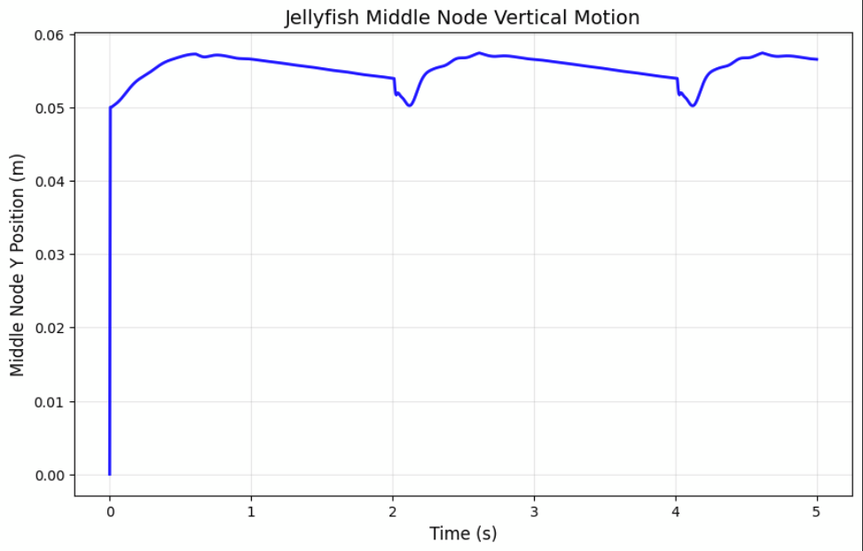
Current Challenges
No noticeable increase in average y-position
Basic resistive force model likely too simple
Reynolds number might be too high for applicability (Re >> 1)
Lack of established stiffness values for real jellyfish
Performance is highly dependent on coordinating contractions
Currently taking a heuristic approach

Slide 4
Future Progress
Implement a more robust hydrodynamic model that accounts for the surrounding sea water
Potentially implement something that accounts for vortices
Increase the number of nodes our model can accurately simulate to create a more wave like motion
Research more accurate values for drag, stiffness, and geometry to more accurately simulate a specific type of jellyfish

Slide 5
References
J. Najem, S. A. Sarles, B. Akle, and D. J. Leo, “Biomimetic jellyfish-inspired underwater vehicle actuated by ionic polymer metal composite actuators,” Smart Mater. Struct., vol. 21, no. 9, p. 094026, Sep. 2012, doi: 10.1088/0964-1726/21/9/094026.
A. Villanueva, C. Smith, and S. Priya, “A biomimetic robotic jellyfish (Robojelly) actuated by shape memory alloy composite actuators,” Bioinspir. Biomim., vol. 6, no. 3, p. 036004, Sep. 2011, doi: 10.1088/1748-3182/6/3/036004.
L. Xiangbin and Y. Junzhi, “Design and simulation of a robotic jellyfish based on mechanical structure drive and adjustment,” in 2015 34th Chinese Control Conference (CCC), Jul. 2015, pp. 5953–5958. doi: 10.1109/ChiCC.2015.7260571.
J. G. Miles and N. A. Battista, “Naut Your Everyday Jellyfish Model: Exploring How Tentacles and Oral Arms Impact Locomotion,” Fluids, vol. 4, no. 3, p. 169, Sep. 2019, doi: 10.3390/fluids4030169.
S. R. Anuszczyk and J. O. Dabiri, “Electromechanical enhancement of live jellyfish for ocean exploration,” Bioinspir. Biomim., vol. 19, no. 2, p. 026018, Mar. 2024, doi: 10.1088/1748-3190/ad277f.

